Slide 1
Application: Liner Fleet Shipping Repositioning Problem

Slide 2
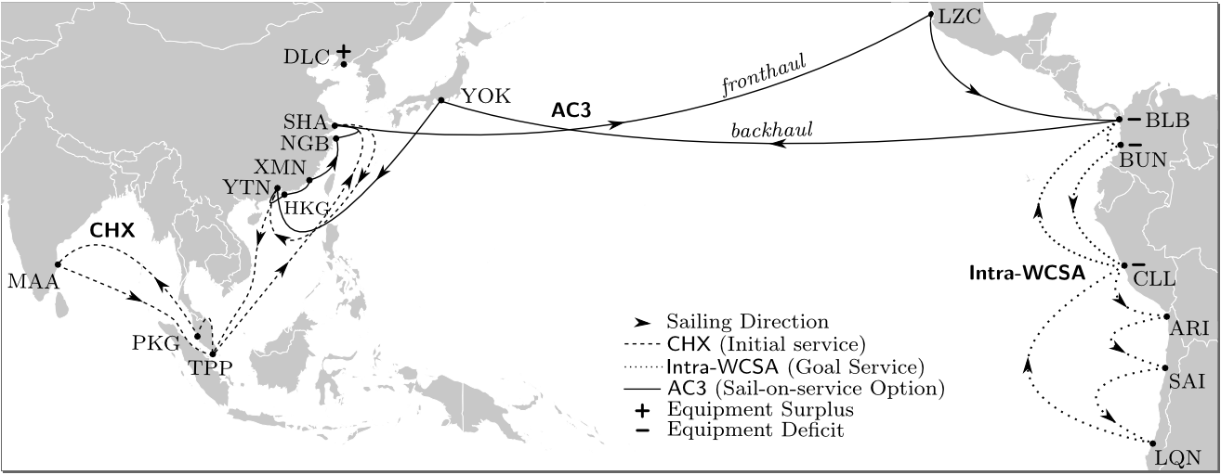
Case Study: Liner Shipping Fleet Repositioning
Repositioning of Ocean Liners Between Services Costs Hundreds of Thousands of Dollars, Planning and Optimisation are Vital.
Time Windows of Opportunity: when can a ship leave a port, when are there opportunities for cross ocean transport?
Continuous cost function: When a ship is sailing have to pay the crew, fuel etc.
"Automated Planning for Liner Shipping Fleet Repositioning." K. Tierney, A. J. Coles, A. I. Coles, C. Kroer, A. Britt, R. M. Jensen. ICAPS (2012)

Slide 3
Phasing in and out
A vessel may only join or leave a service at the time that service is due to arrive in a port.
Planning model:
(at 16 (vessel-may-phase-out vessel0 pMYTPP))
(at 16.1 (not (vessel-may-phase-out vessel0 pMYTPP)))
(at 61 (vessel-may-phase-out vessel0 pTHLCH))
(at 61.1 (not (vessel-may-phase-out vessel0 pTHLCH)))
(at 158 (vessel-may-phase-out vessel0 pHKHKG))
(at 158.1 (not (vessel-may-phase-out vessel0 pHKHKG)))
… 70 time windows
And for phasing in:
(at 504 (vessel-may-phase-in pPABLB))
(at 504.100000 (not (vessel-may-phase-in pPABLB)))
(at 1680.100000 (not (vessel-may-phase-in pPABLB)))
(at 552 (vessel-may-phase-in pCOBUN))
… 55 time windows

Slide 4
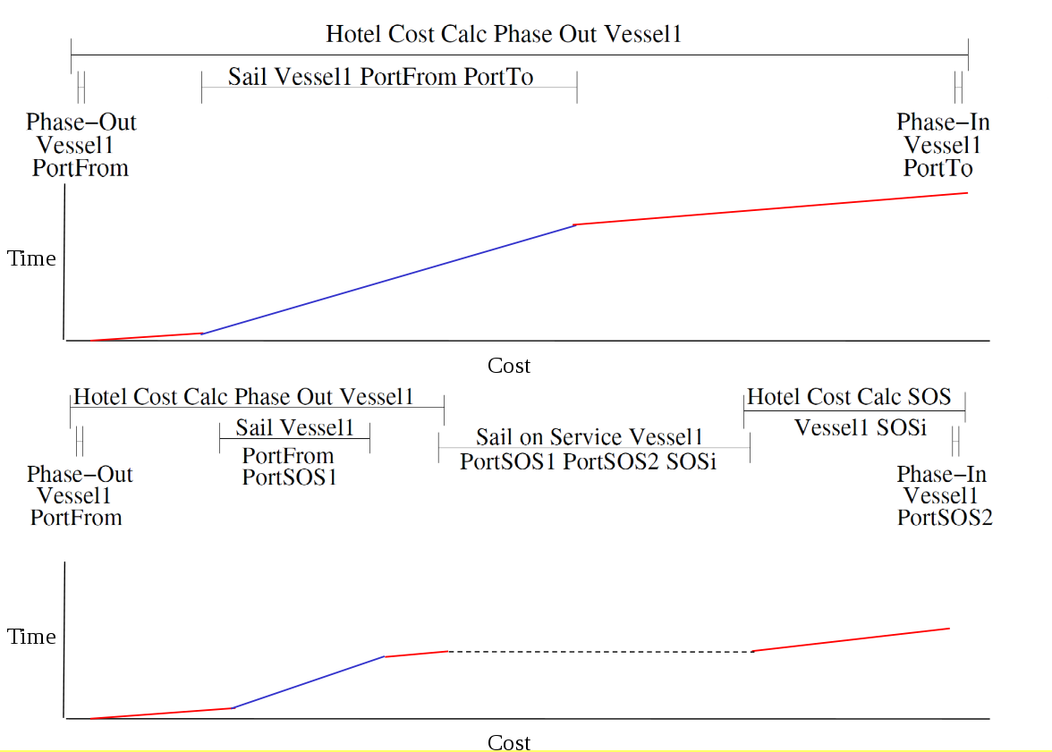
LSFRP Model

Slide 5
Solving the LSFRP
Optimisation
Solver (MIP)
Planner
Actions
(incl. costs)
Time
Windows
OPTIC
Actions
Costs & Time
Windows
LTOP
MIP
LTOP is faster than both the MIP and Planner
"Automated Planning for Liner Shipping Fleet Repositioning." K. Tierney, A. J. Coles, A. I. Coles, C. Kroer, A. Britt, R. M. Jensen. ICAPS (2012)

Slide 6
The Future
Non-linear continuous change.
Exploring the division of the problem between planner and optimisation solver.
Scaling up to even larger problems.
Applications.
All of these planners, and more, are open source and available to download for free from the planning at King’s website: http://nms.kcl.ac.uk/planning/

Slide 7
Extending OPTIC to Reason About Processes and Events
Planning with Exogenous Processes and Events:
"PDDL+ Planning with Events and Linear Processes." A. J. Coles and A. I. Coles. ICAPS (2014).
https://www.youtube.com/watch?v=qBTtw5TINIk
"PDDL+ Planning with Events and Linear Processes." A. J. Coles and A. I. Coles. ICAPS (2014).

